Slide 1
BRITISH AIRWAYS
CUSTOMER RATINGS ANALYSIS AND INSIGHTS

Slide 2
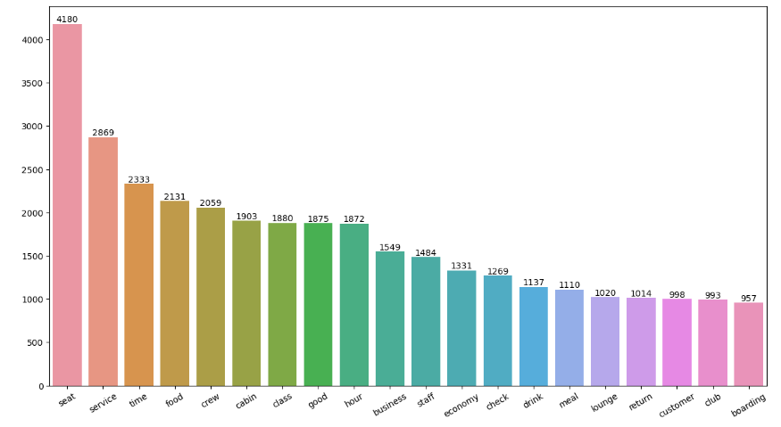
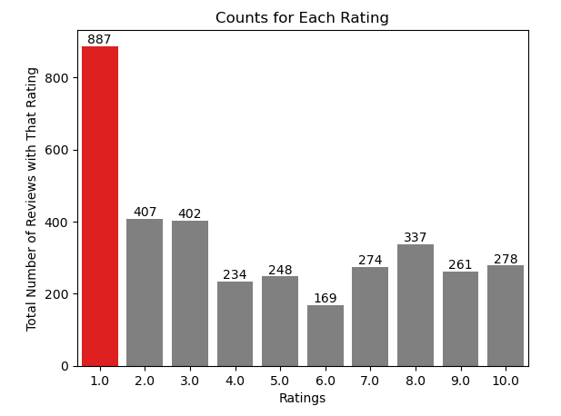
KEY METRICS
Average Overall Rating 4.52/10
Reviews from 71 Countries
3497 Total reviews collected
What customers are happy and unsatisfied about for different ratings class:
7-10 Rating wrote about: Quick security check, Good food, Comfortable seats
4-6 Ratings faced problems with: Customer service, Tv screen size, Poor boarding process.
1-3 Ratings wrote dissatisfaction on: Overall experience, Congested middle seat while they liked Cabin crew and mentioned arrival is on time.
All customers liked Cabin crew service and staff.
Many travelled in Business class.

Slide 3
Focus on:
Improvement in Customer Service
Enhance inflight entertainment
Business Class:
Improving Business Class Seats
Value for money
Reduce Delays

